Slide 1



K&O Personnel Management Systems
Created by: Jon King, Anthony Orengo

Slide 2


Team
Jon King
Anthony Orengo

Slide 3
About K&O
K&O Personnel Management System is a web-based application that uses a database to access and store user data, so organizations can better track and monitor their employees.

Slide 4
The K&O Mission
“To create a secure and reliable personnel management system for all organizations worldwide”

Slide 5
The K&O Vision
“Efficient and reliable tracking system for all organizations big & small”

Slide 6
Problem
Personnel Management Record Keeping
Employee Progress

Slide 7
Solution
Create a personnel management system that tracks employee in and out times by use of a barcode system.

Slide 8


Technologies Used

Slide 9

Technologies Used
Hardware Technologies
Software Technologies
Coding Languages
Laptop with suitable ports
Projector with accessories
Realinn RL6200 Barcode Scanner
Java Netbeans IDE
SQL Plus
Free MySQL Hosting
AWS(Elastic Beanstalk/Route 53)
Maria DB
Paint 3D
PowerPoint
Adobe Photoshop
Free Logo Design
Java, JSP
SQL
HTML
CSS
Javascript

Slide 10
User Stories

Slide 11
User Stories Cont.
# 1. EPIC - As an administrator, I want to be able to track my employees/student's attendance.
Responsive Webpage: As a user, I want a responsive website, so I can view the website on various devices(laptop, desktop, mobile devices).
ADD MORE

Slide 12
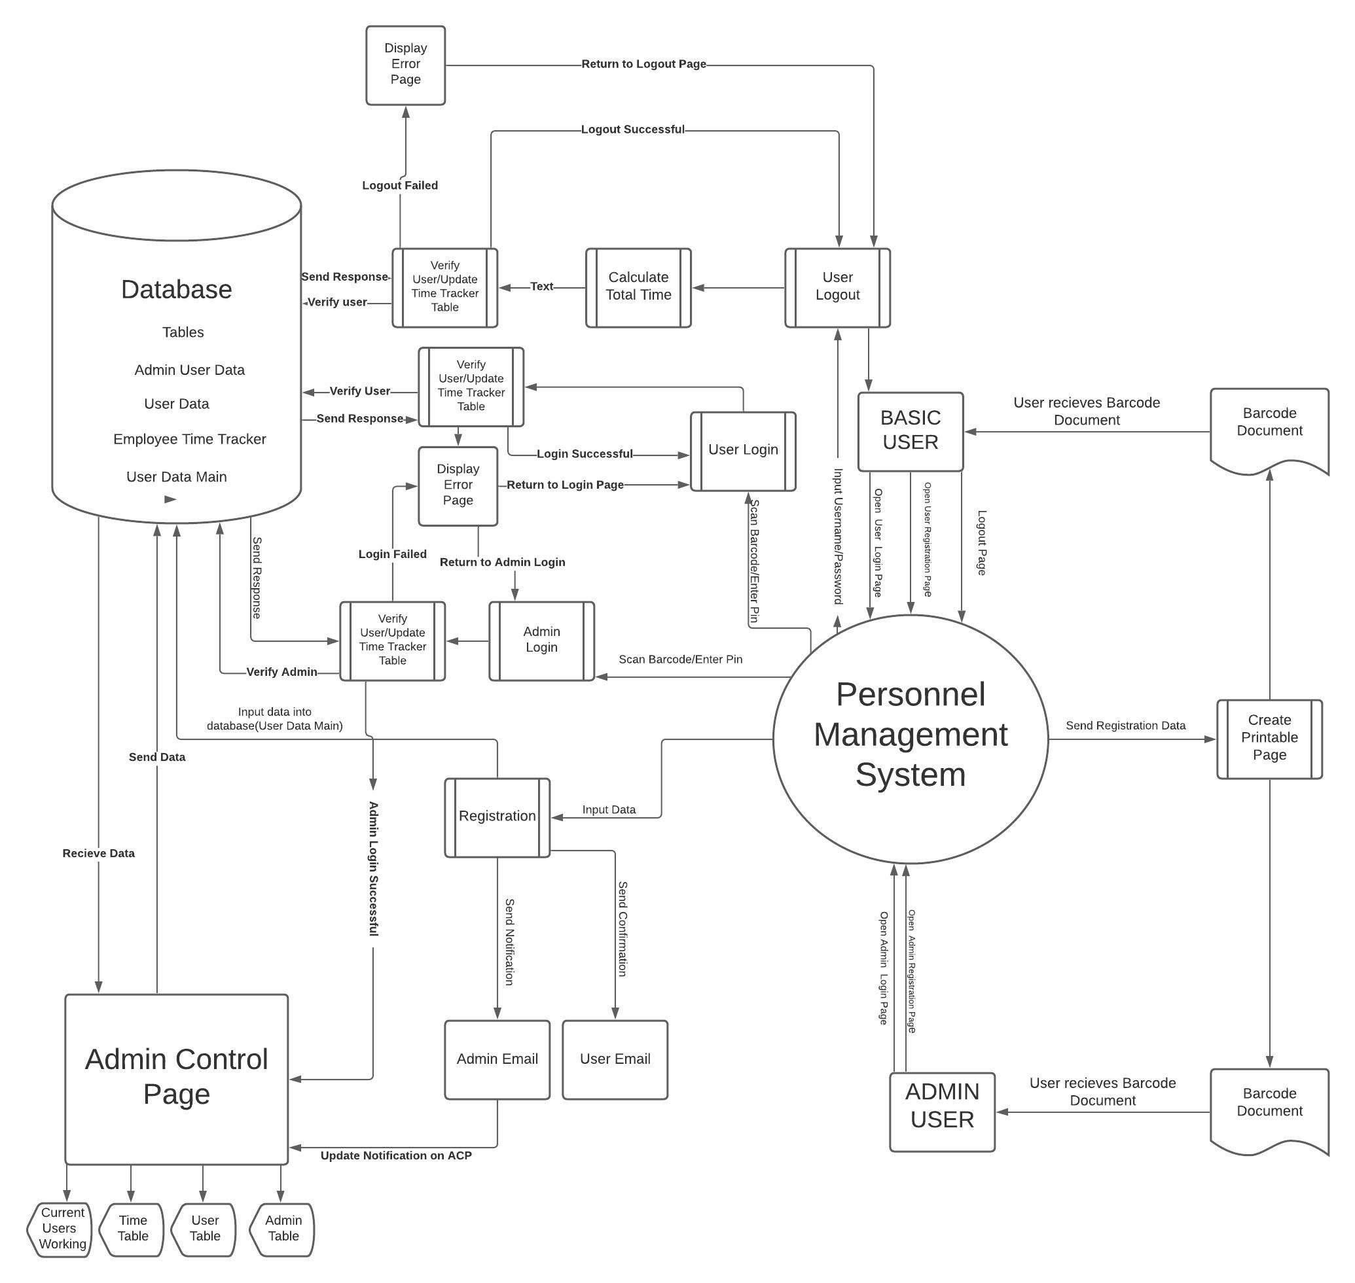
Context Diagram

Slide 13

Application Security

Slide 14

Application Security
Security Methods
SQL----
HTTPS
Key Pair

Slide 15
Backend

Slide 16
Frontend Security
Content Security Policy

Slide 17

Live Demo

Slide 18
Questions?
Created by: Jon King, Anthony Orengo

